Slide 1

Graph Visualization - tfgraphviz

Slide 2

Reference
Chapter 9 (O'Reilly) of Hands-On ML
tfgraphviz
Youtube
Code

Slide 3
tfgraphviz

Slide 4
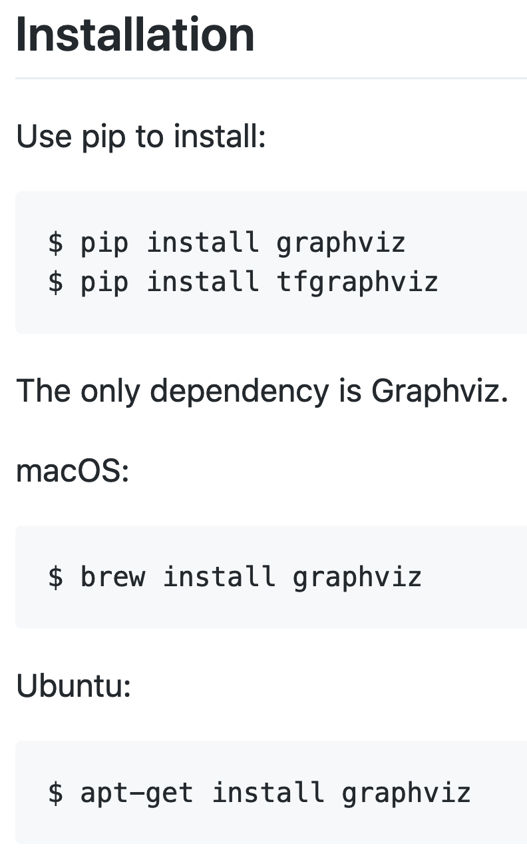
tfgraphviz

Slide 5
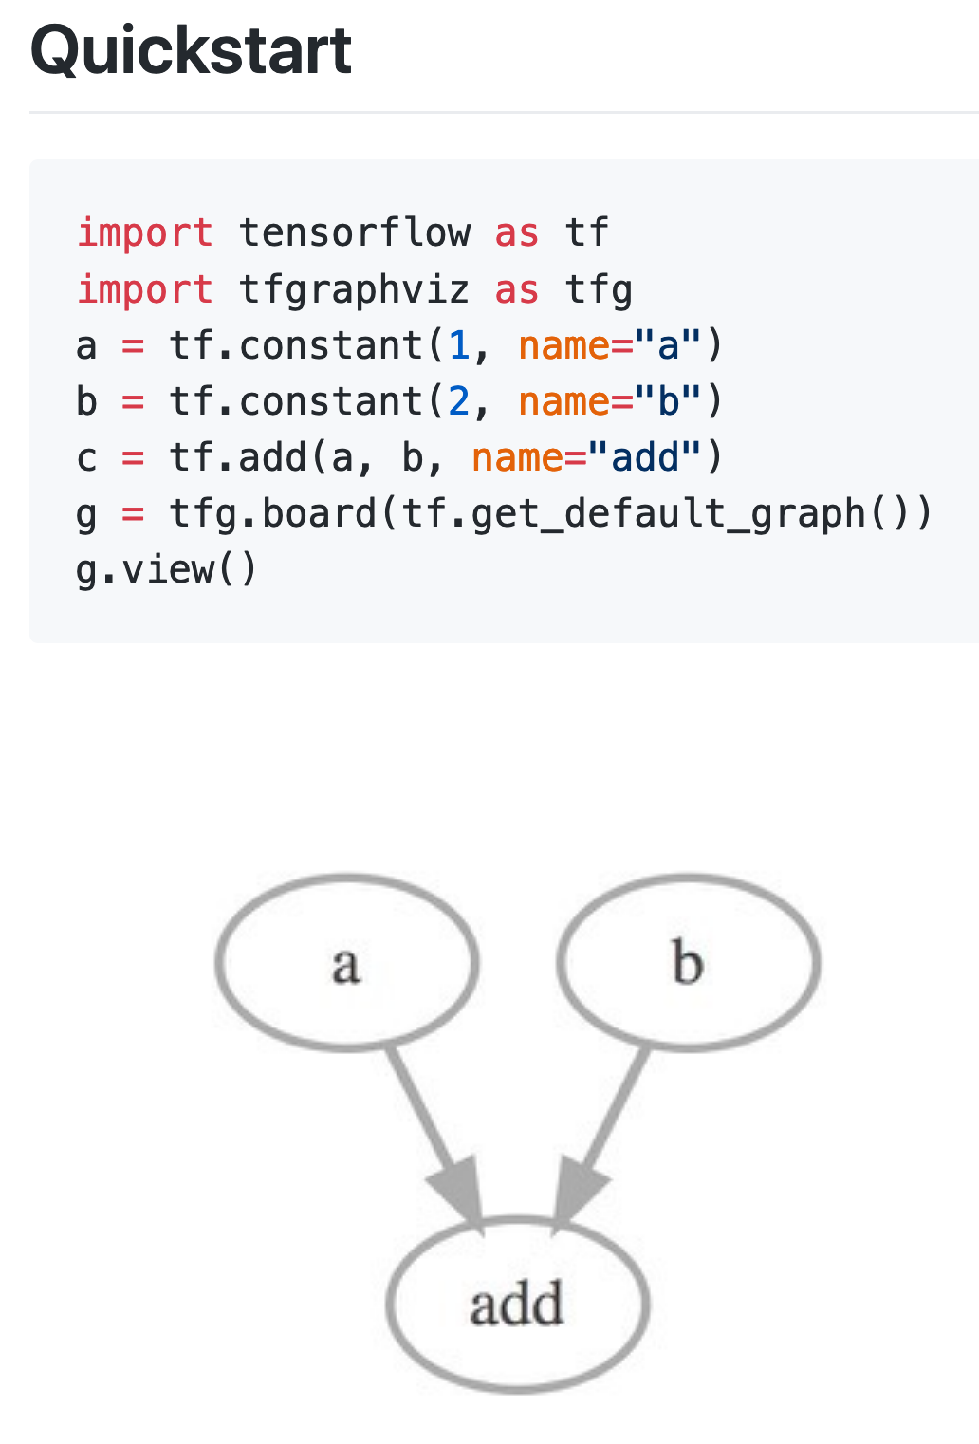
tfgraphviz

Slide 6
tfgraphviz

Slide 7
tfgraphviz

Slide 8
tfgraphviz

Slide 9
Data

Slide 10
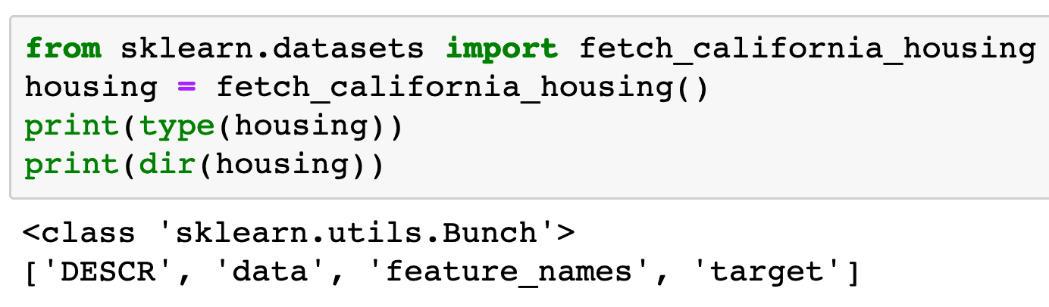

Slide 11
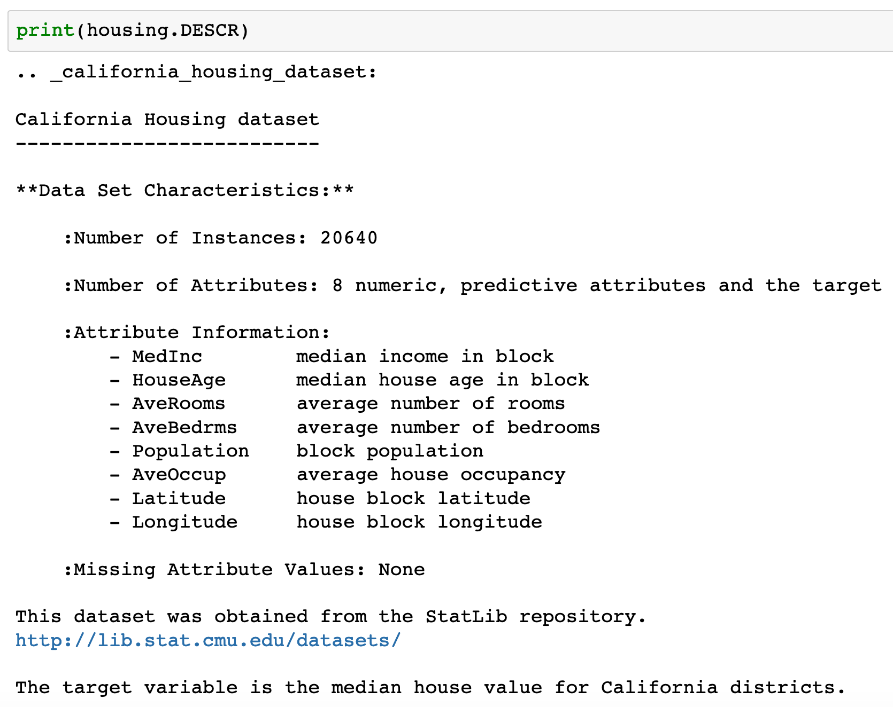

Slide 12
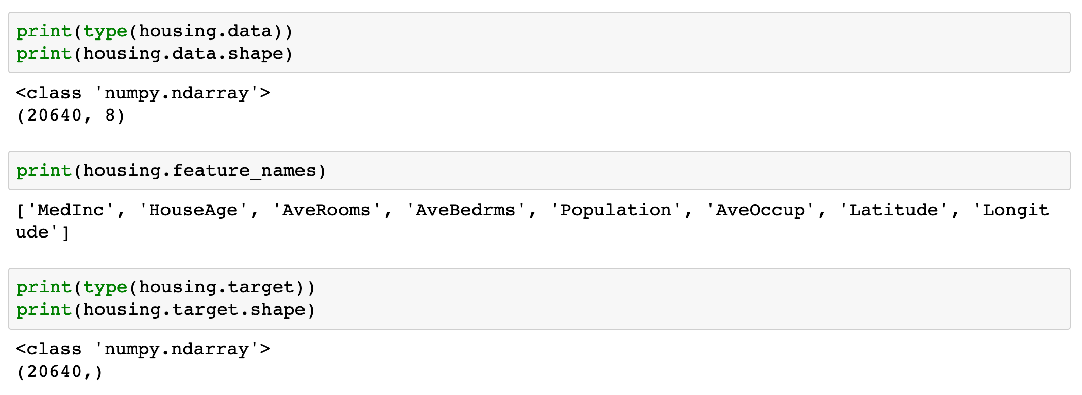

Slide 13
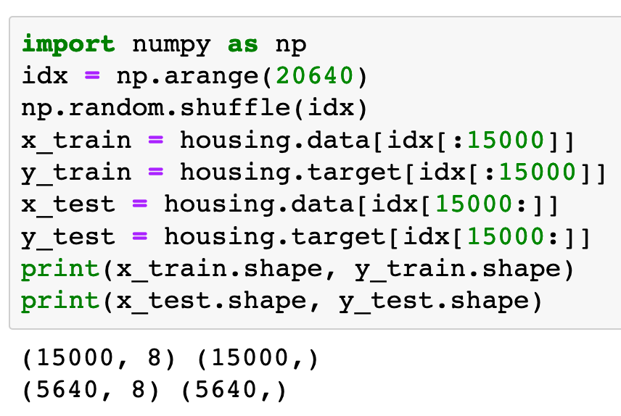

Slide 14
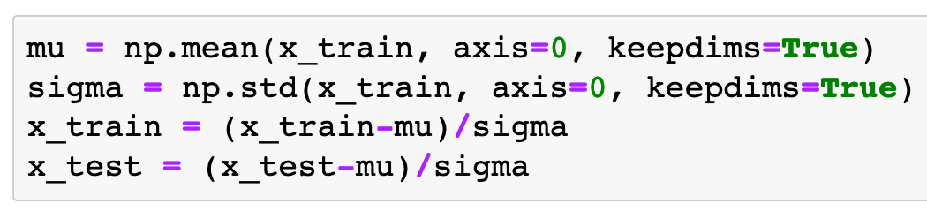
Input Normalization

Slide 15
Warm Up

Slide 16
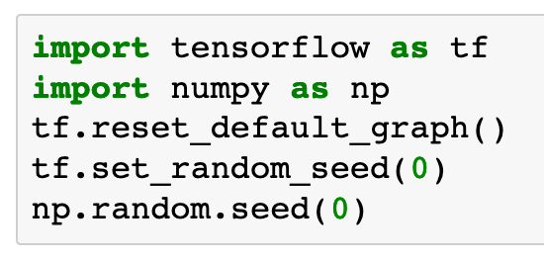

Slide 17
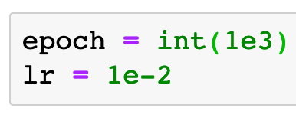

Slide 18
Graph

Slide 19
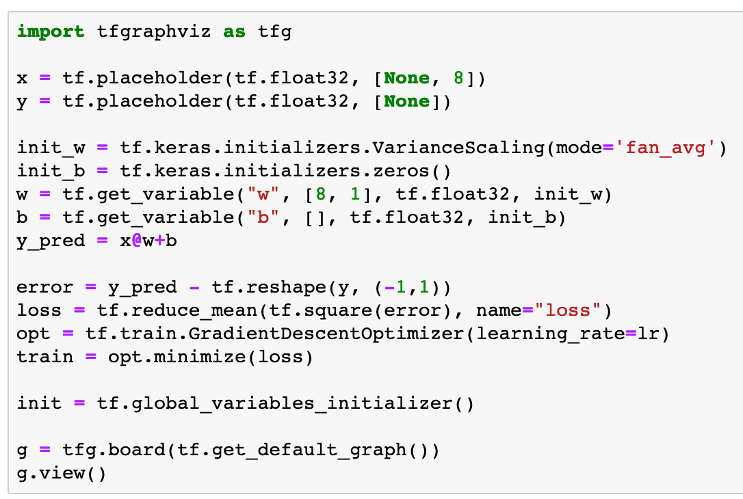

Slide 23
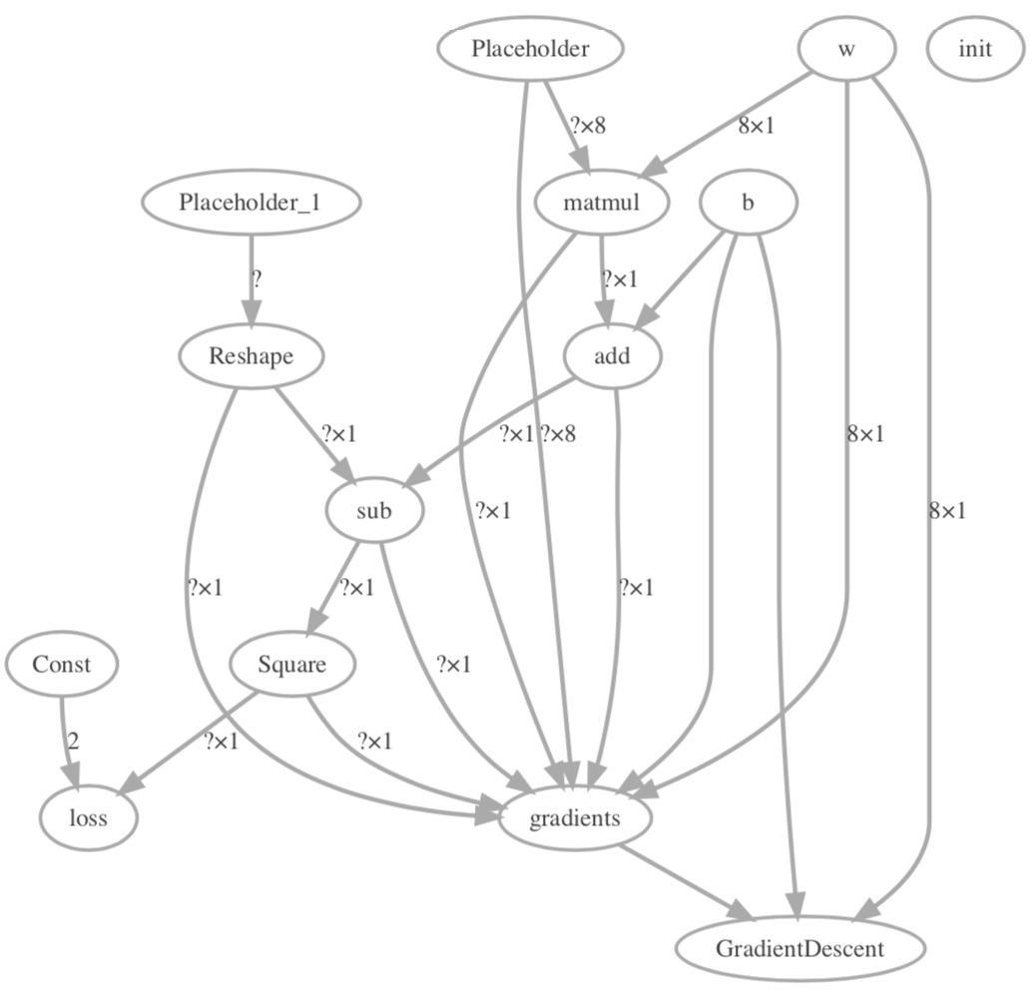

Slide 24
Session

Slide 25
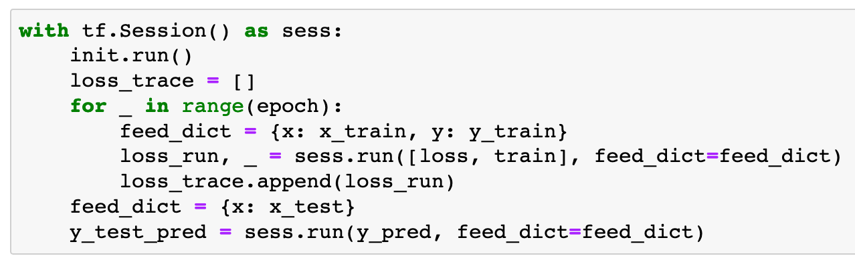

Slide 26
Report

Slide 27
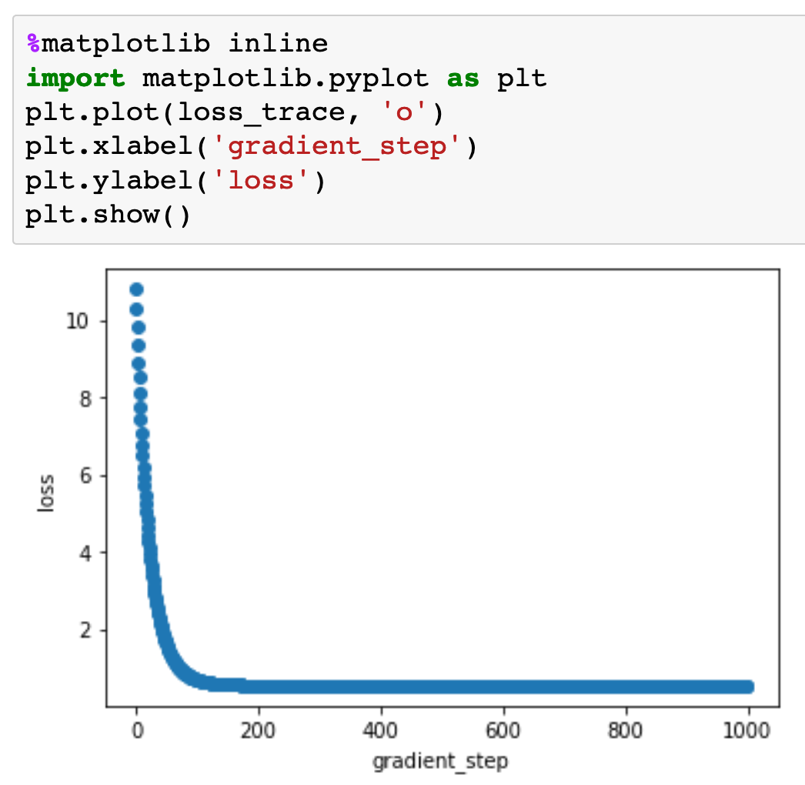

Slide 28
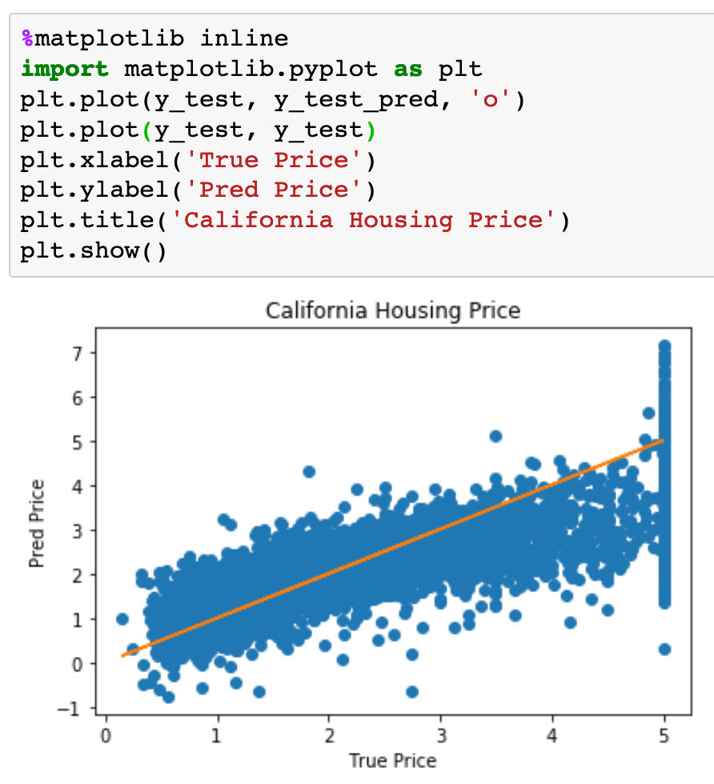

Slide 29
Now
Let’s Play with Code

